Slide 1
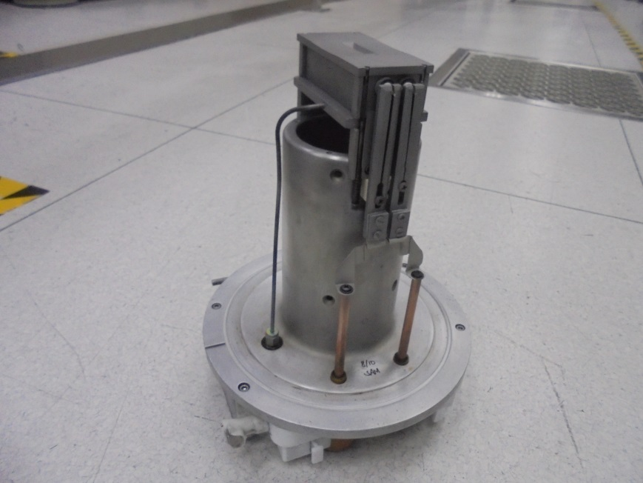
第二週新人週報
工號:1200106
姓名:黃劭宸
到職日:109/03/30

Slide 2
E500 SOURCE HEAD
DISMANTLING
ASSEMBLE
ISOLATION TEST
引用自SAMUEL - 山姆爾的E500 SOURCE HEAD Maintenance Guideline

Slide 3
DISMANTLING
OF COMPONENTS

Slide 4
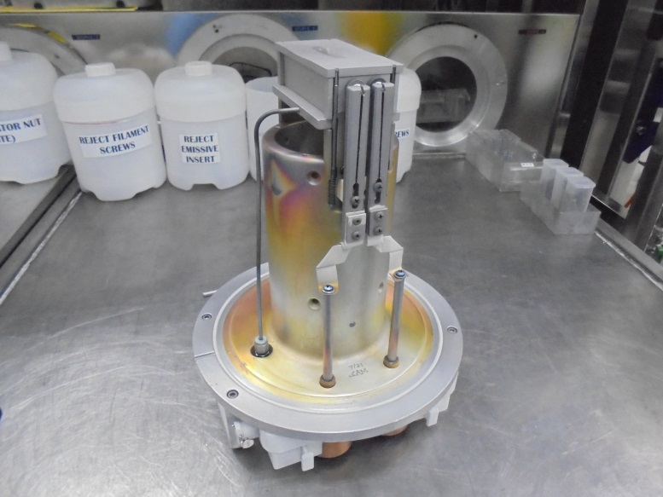
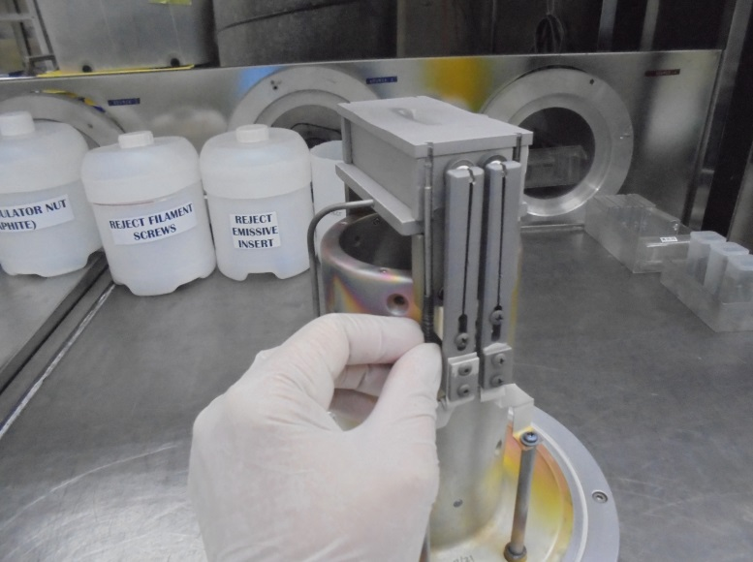
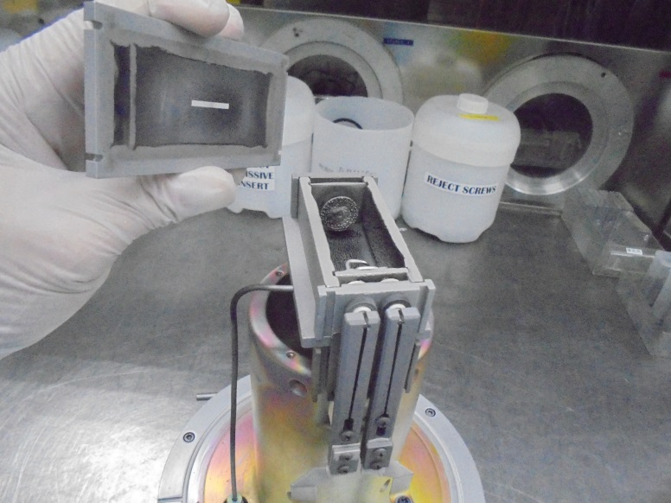
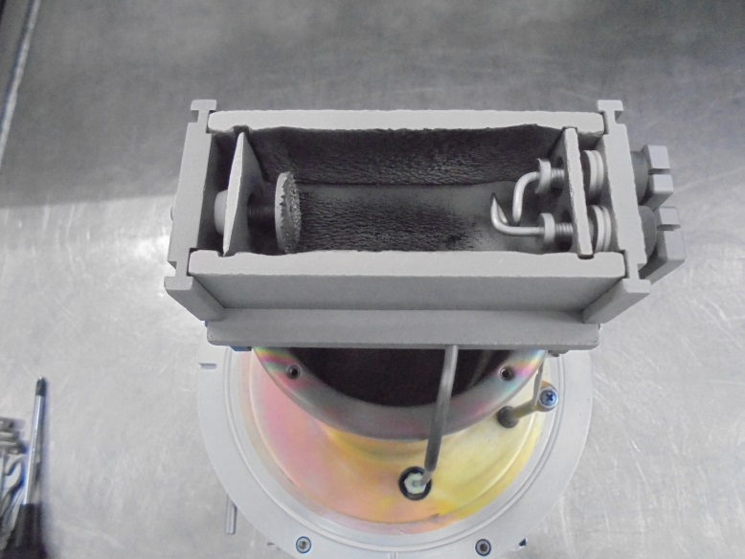
1
-SPARE for MAINTENANCE-
REMOVE THE RETAINER PIN [4 PCS.]
把retainer pin往上推起 再向外拉出
2
3
FILAMENT
TAKE-OUT THE ARC SLIT
INSIDE THE ARC CHAMBER
[BURN-OUT FILAMENT]

Slide 5
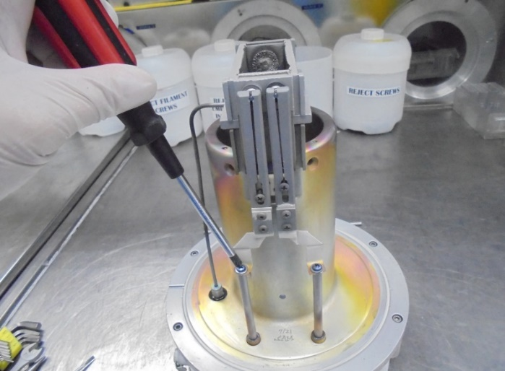
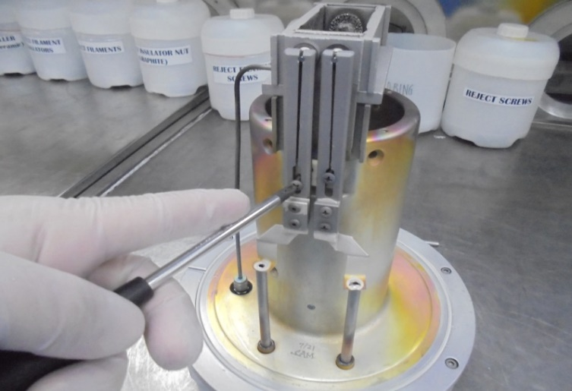
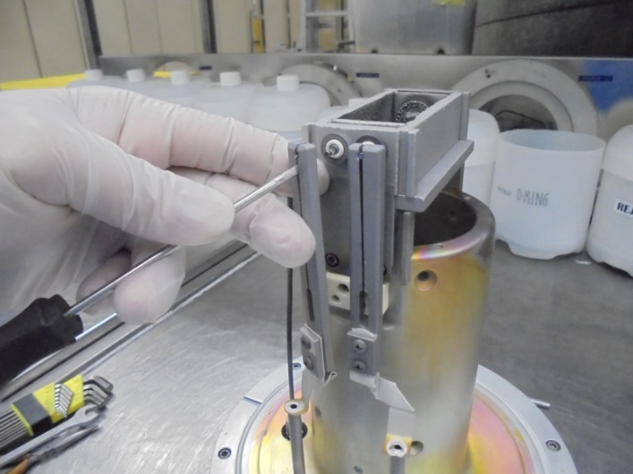
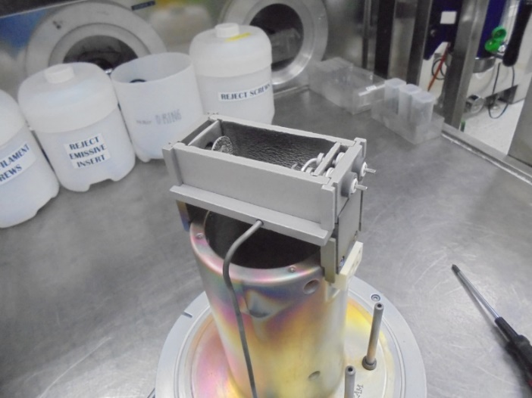
4
5
FEED STRAP
FILAMENT
FEED-THRU
REMOVE 2 SCREWS CONNECTING THE
FILAMENT FEED-THRU and FEED STRAP
REMOVE 2 SCREW OF FILAMENT CLAMP
用十字起把連接FILAMENT FEED-THRU和FEED STRAP的兩顆螺絲還有固定FILAMENT CLAMP
的兩顆螺絲轉出
5
6
CAREFULLY TAKE-OUT THE FILAMENT CLAMP
ATTACHED ON FILAMENT END
NOW YOU CAN FREELY DE-ATTACHED THE
ARC CHAMBER ASSEMBLY
用一字起把夾住FILAMENT 的FILAMENT CLAMP的縫隙撐開後 即可取出

Slide 6
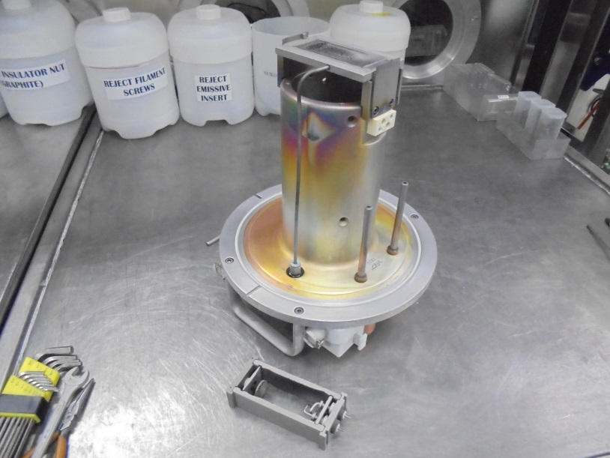
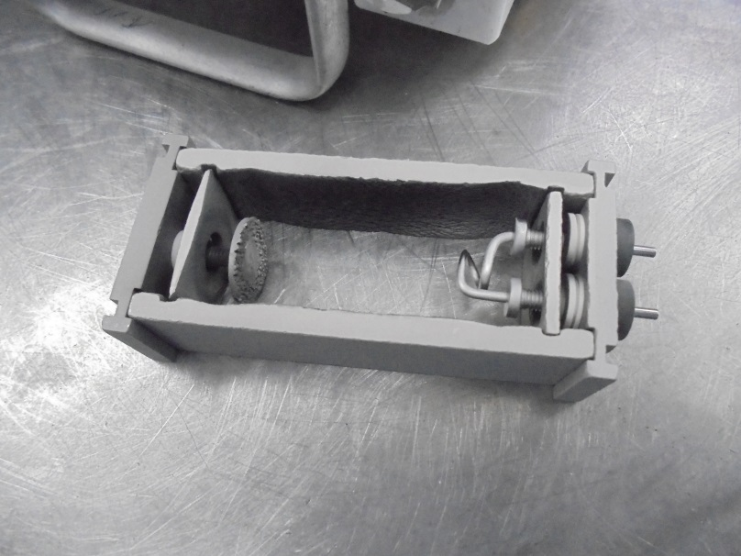

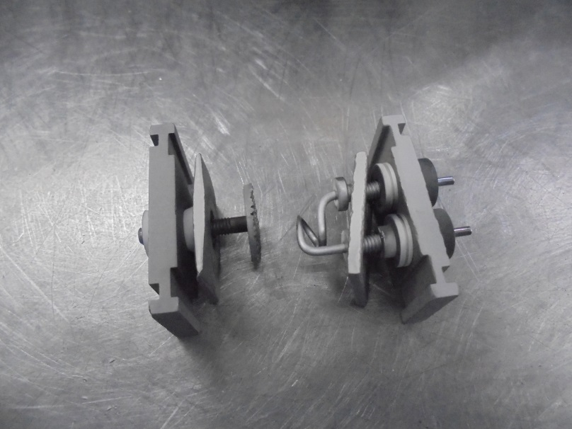
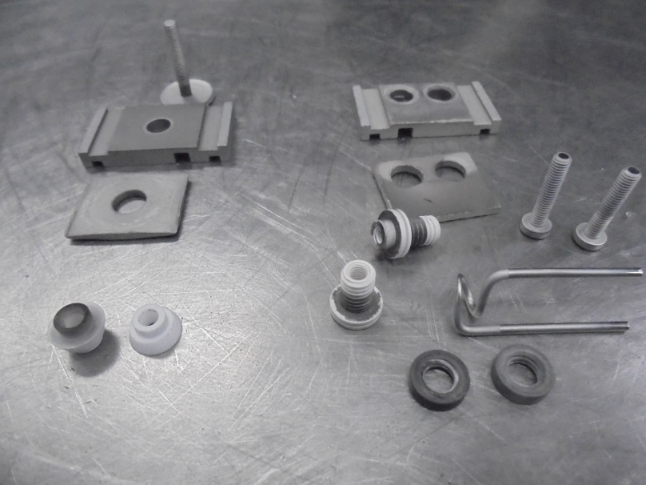
7
8
REMOVE ARC CHAMBER [step-aside]
REMOVE THE SIDE PLATES
9
10
REMOVE THE CONSUMABLE PARTS ON
REPELLER END and FILAMENT END
COLLECT THE USED CONSUMABLE PARTS
AND PUT IT ON THE ASSIGN SCRAP BINS.

Slide 7
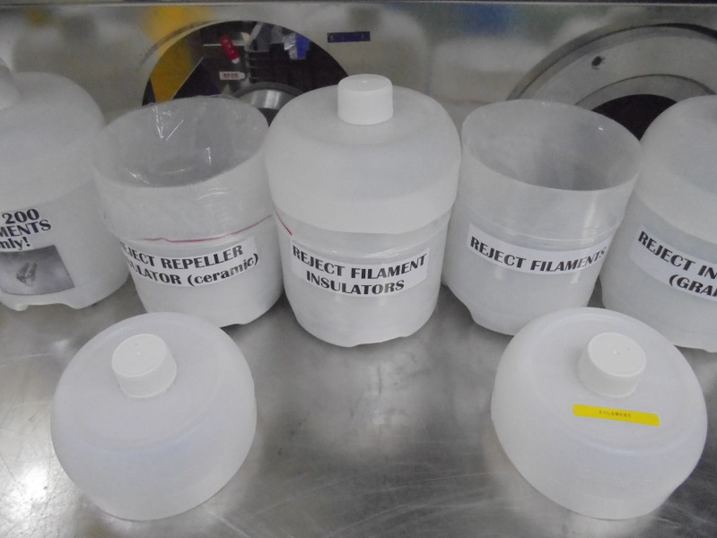
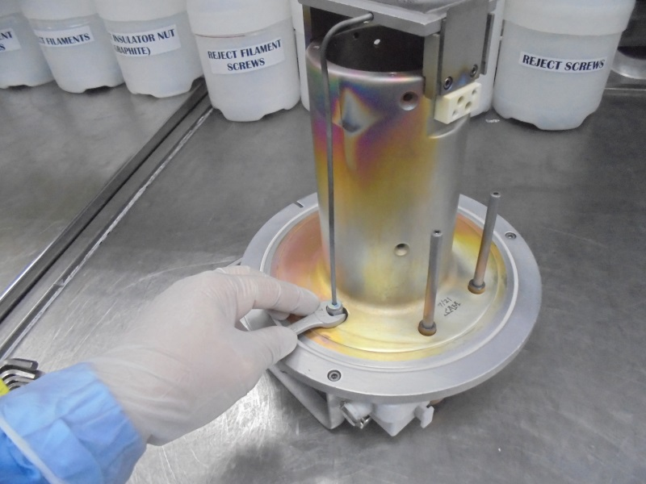
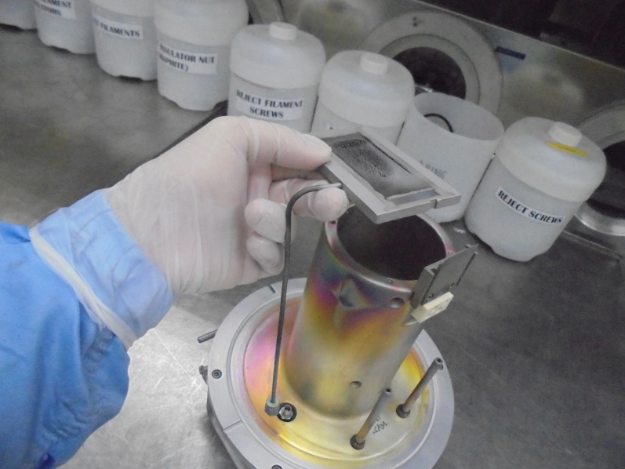
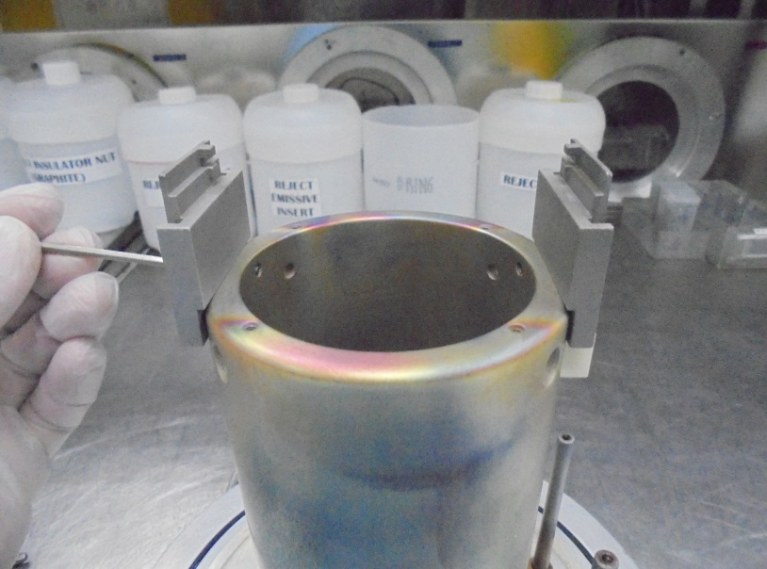
11
12
ASSIGN SCRAP BINS
LOOSEN THE GAS LINE SUS
13
14
BOTTOM
SUPPORT
TOP
SUPPORT
TAKE-OUT THE BASE PLATE and Gas Feed Tube
REMOVE THE TOP and BOTTOM SUPPORT PLATE

Slide 8
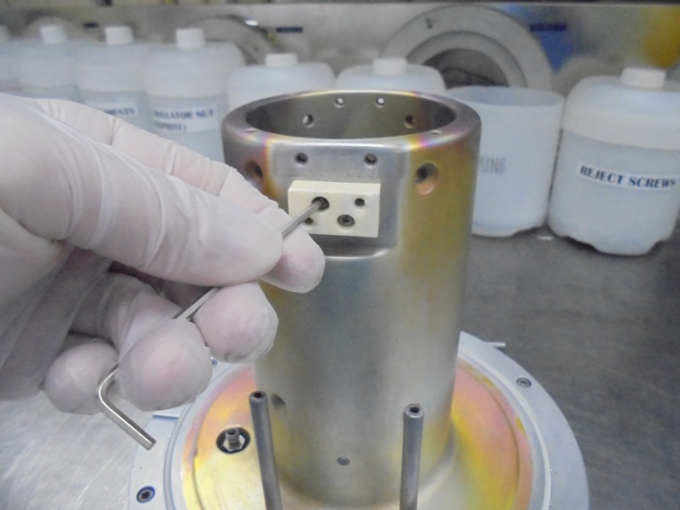
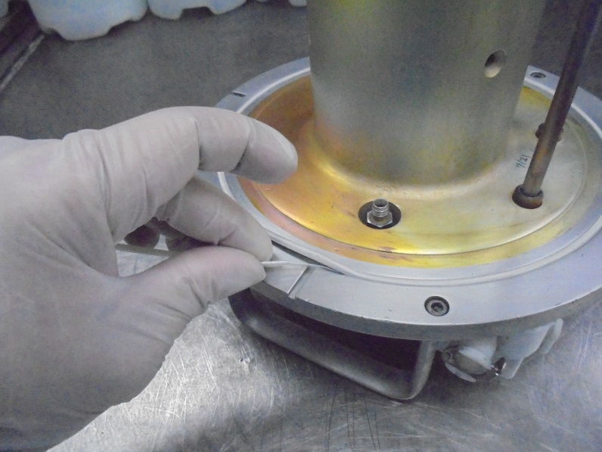
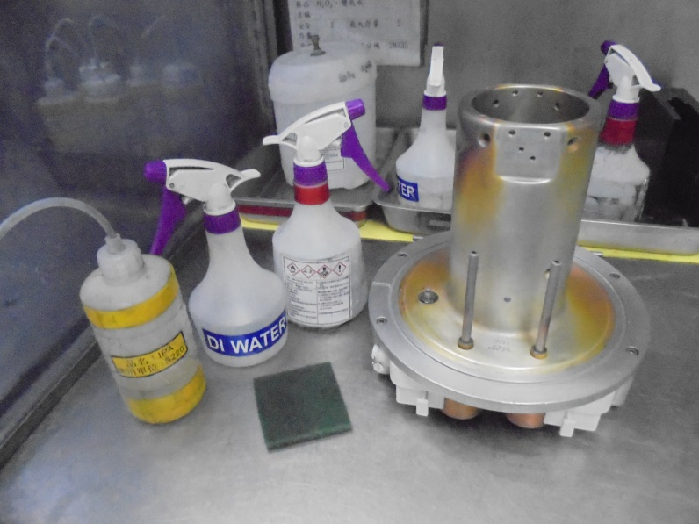
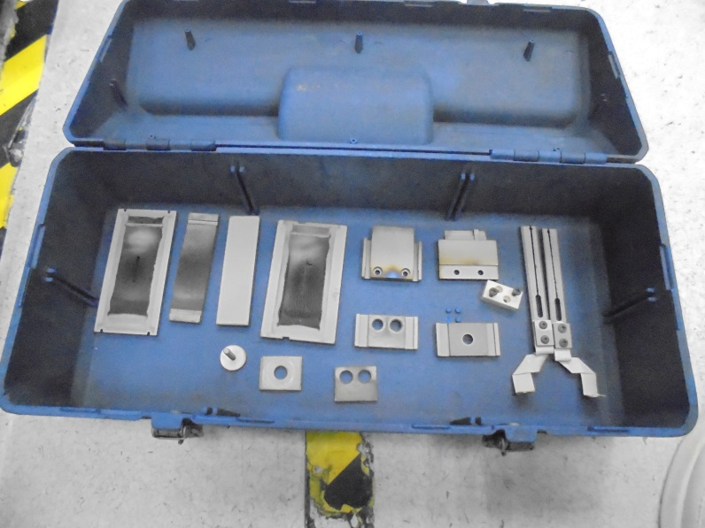
15
16
REMOVE THE FILAMENT CLAMP INSULATOR
REMOVE THE O-RING
17
18
CLEAN THE SOURCE BODY USING H202, SCRUB IT WITH DISH SCRUBBER, RINSE WITH D.I. WATER, SPRAY THE SURFACE WITH AIR SPRAY and WIPE WITH IPA… LET IT DRY
OTHER COMPONENTS CLEAN IT ON
SAND BLAST CLEANER

Slide 9
ASSEMBLE
OF COMPONENTS

Slide 10
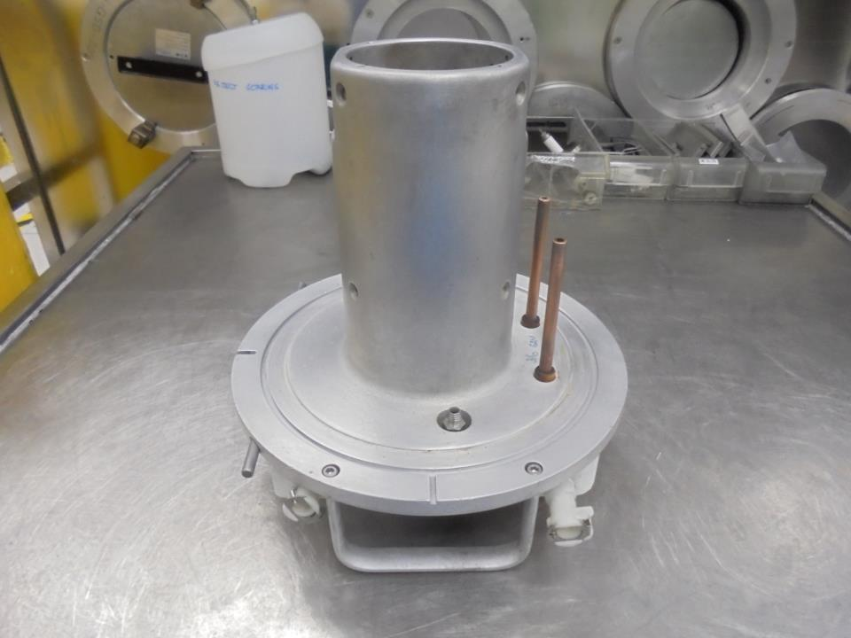
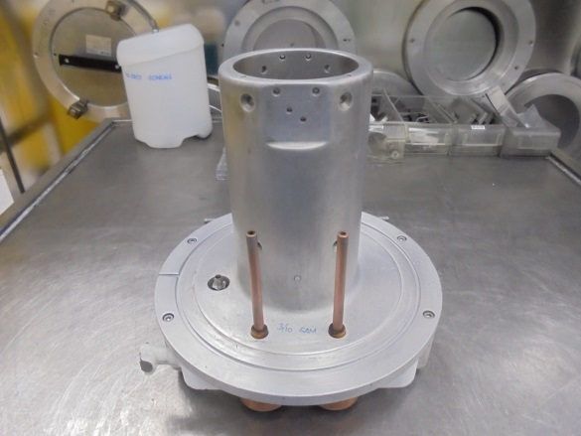
Filament FEED-THRU
E500 SOURCE HEAD BODY

Slide 11
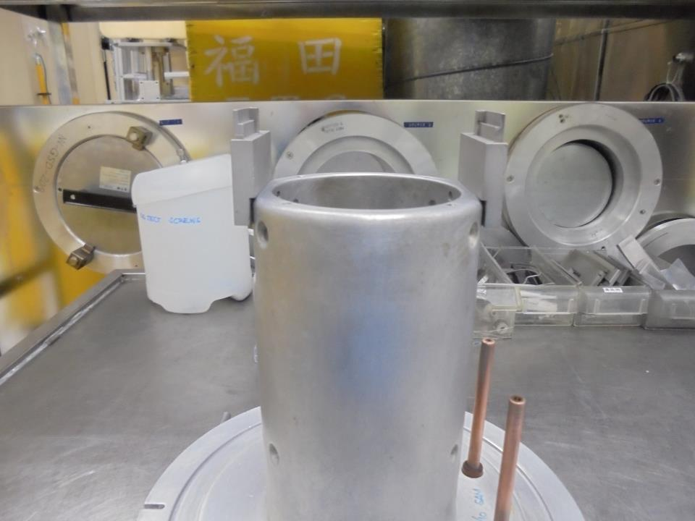
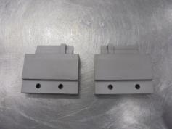
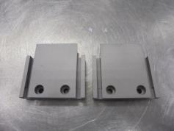
TOP/BOTTOM
SUPPORT PLATE
Install
Inner Face
Outer Face

Slide 12
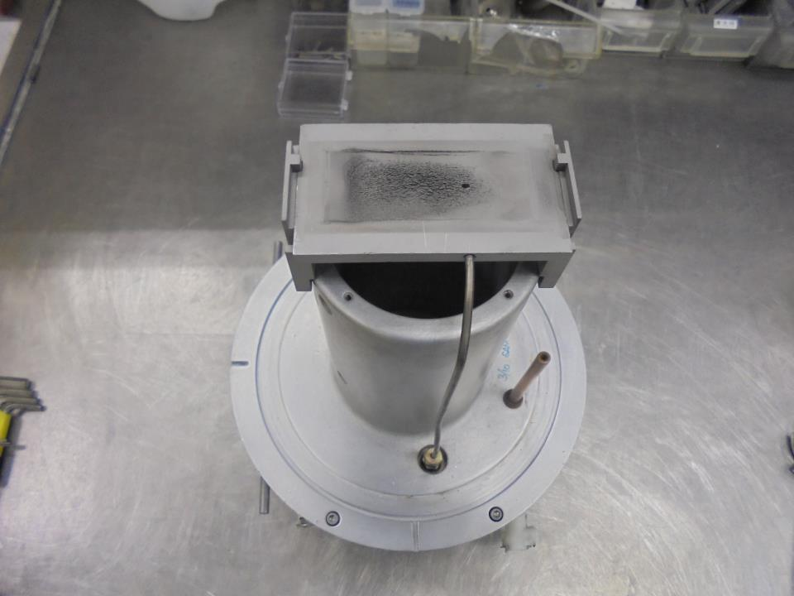
*Notice The Proper Orientation Of
Locator Slot While Installing The
TOP and BOTTOM SUPPORT Plate
Gas Hole
Install The
BASE PLATE
Gas Feed Tube
Filament Feed-Thru Rod (+)

Slide 13
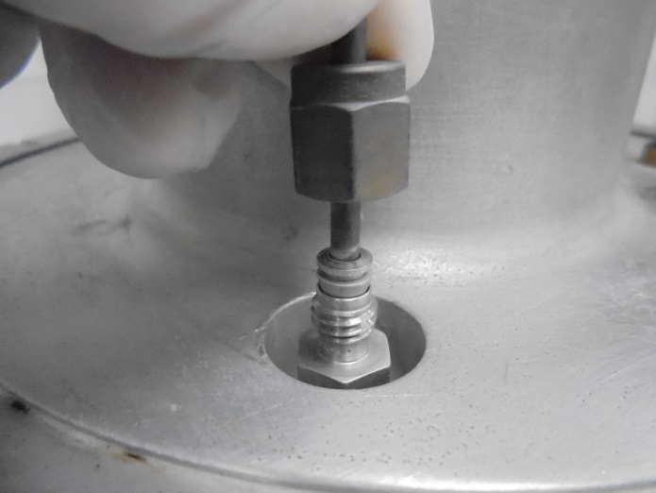
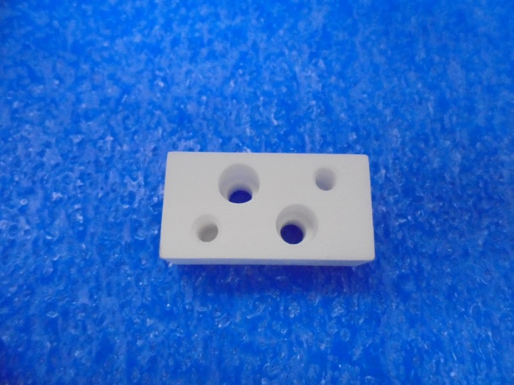

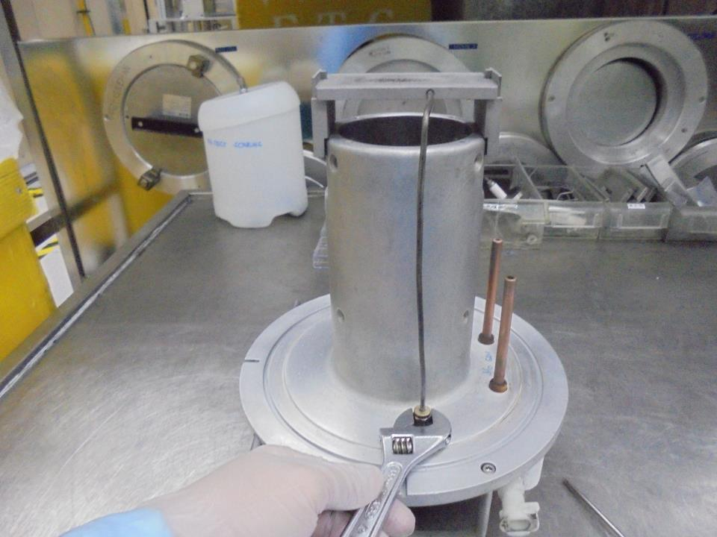
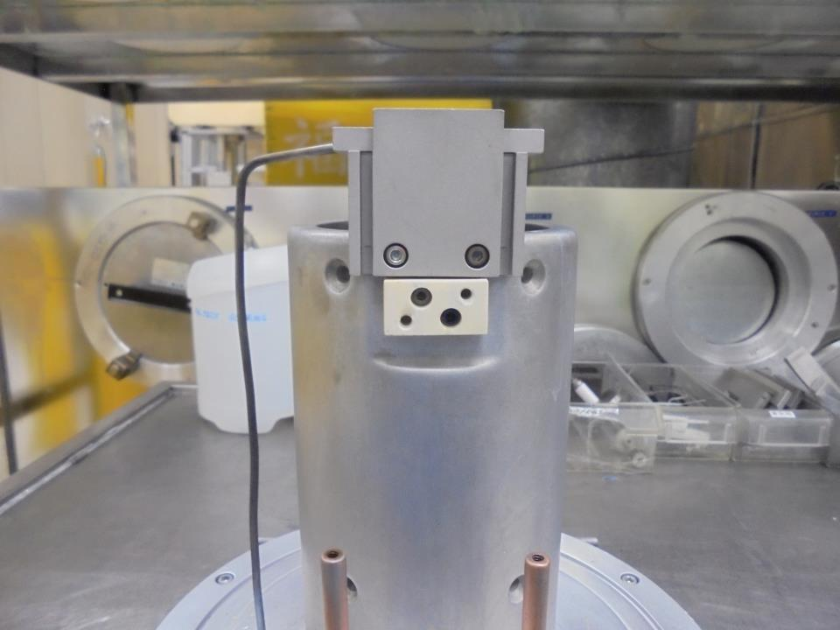
MAKE SURE THAT THE GAS FEED TUBE and GAS FEED-THRU is
CLOSELY ALIGN
BEFORE TIGHTEN SUS
FILAMENT
CLAMP
INSULATOR
GAS FEED TUBE
GAS FEED-THRU
TIGTHEN
the SUS
Install Here!

Slide 14
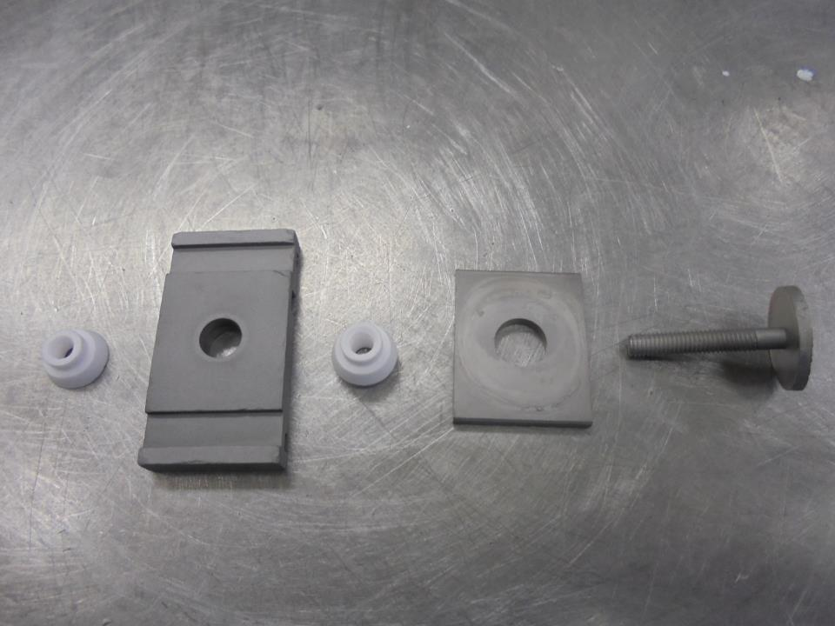
ASSEMBLE THE FOLLOWING REPELLER END COMPONENTS
CERAMIC INSULATOR
SHORT
LONG
REPELLER
BOTTOM SHIELD END PLATE
BOTTOM END PLATE

Slide 15
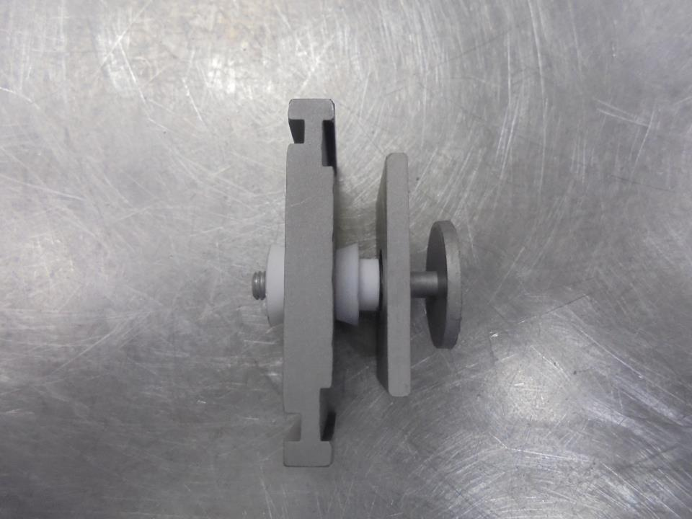
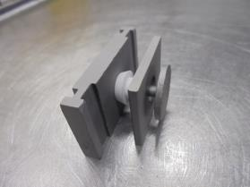
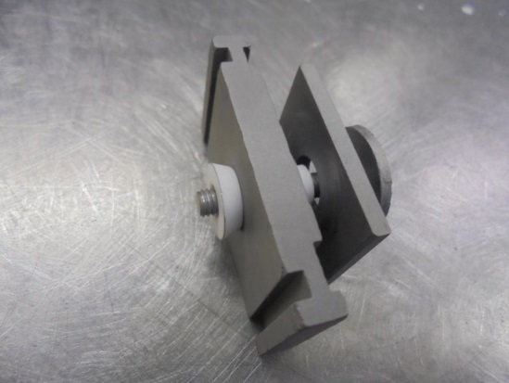
REPELLER END
Slot For
SIDE PLATES
At Least 3 Lines Of Thread
Protrude (alignment matter)

Slide 16
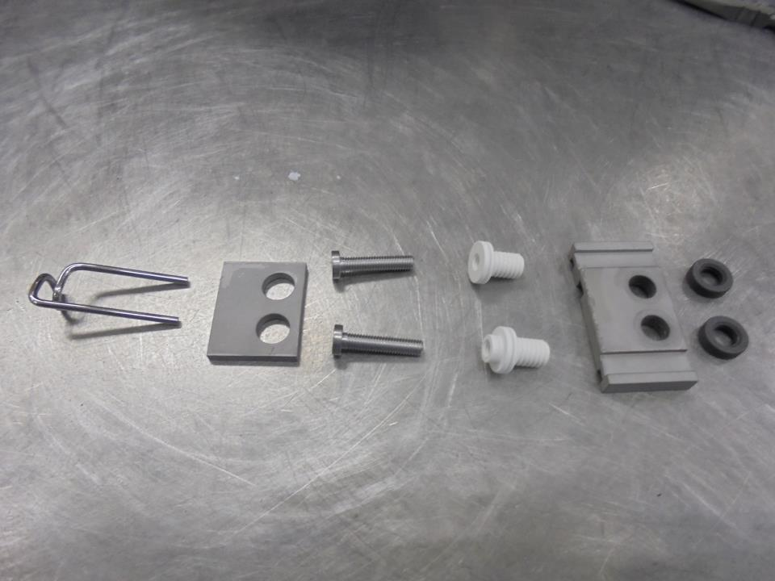
ASSEMBLE THE FOLLOWING FILAMENT END PLATE COMPONENTS:
INSULATOR
NUT
FILAMENT
FILAMENT
SHIELD
FILAMENT
SCREW
FILAMENT INSULATOR
END CAP
PLATE

Slide 17
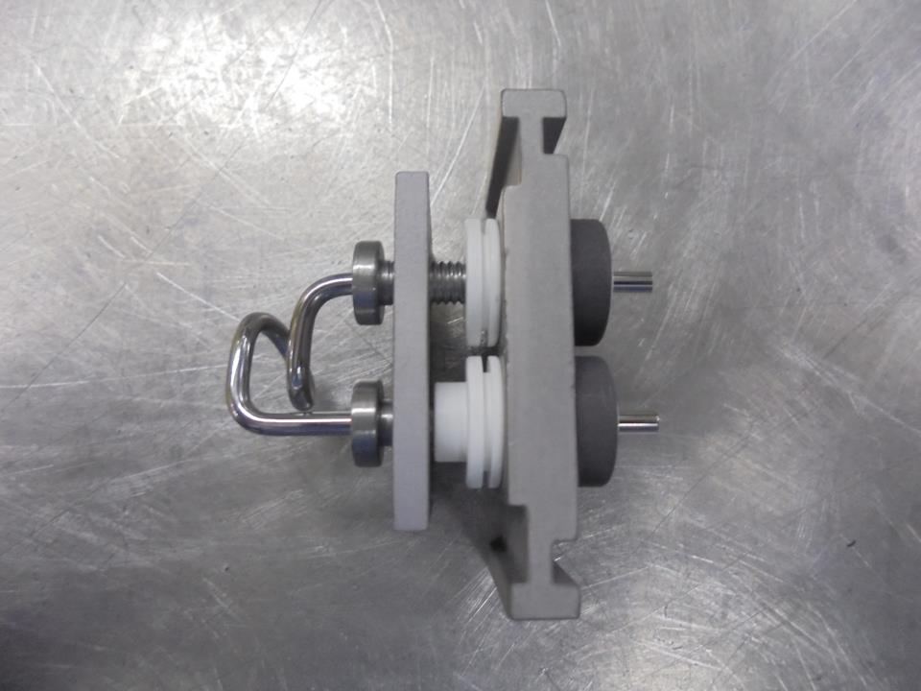
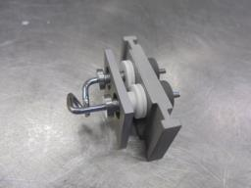
FILAMENT END PLATE
FILAMENT CLAMP
Install Here!

Slide 18
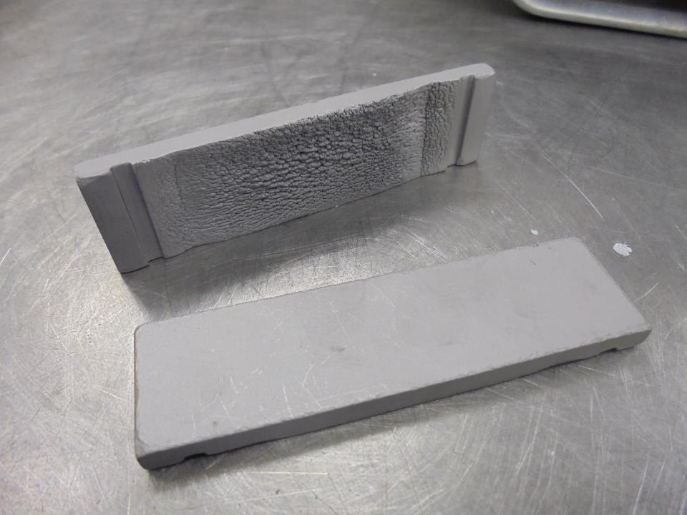
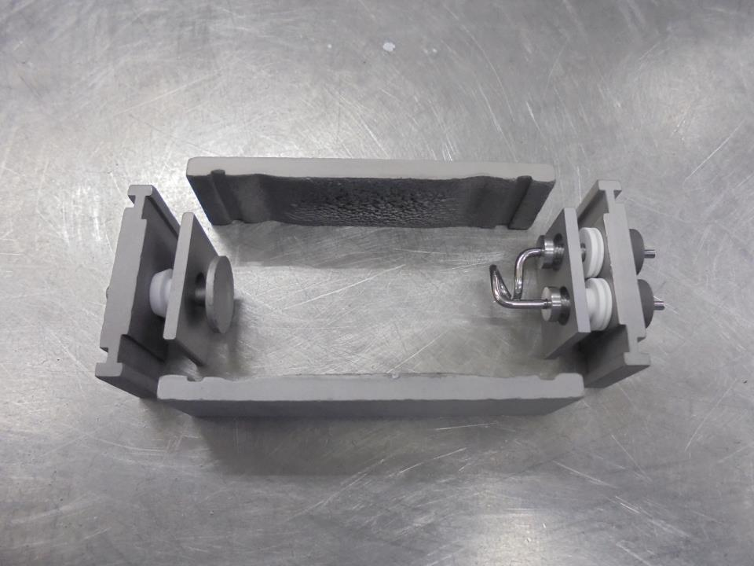
ARC CHAMBER SIDE PLATES
Assemble The Arc Chamber Parts
Check If The SIDE PLATES Slot is 1.0 mm DEEP…
If Not or It Cannot Hold In Place Both FILAMENT
and REPELLER SHIELD… Replace New SIDE PLATES

Slide 19
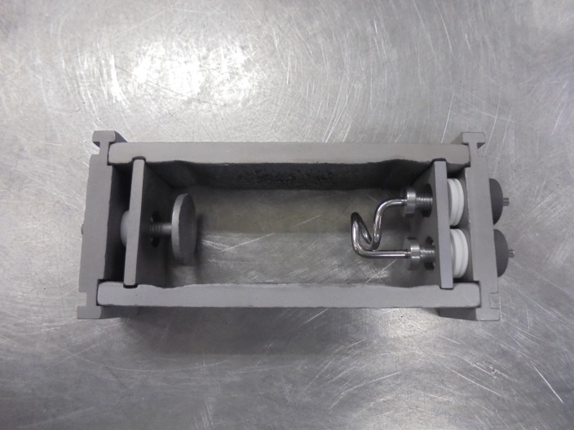
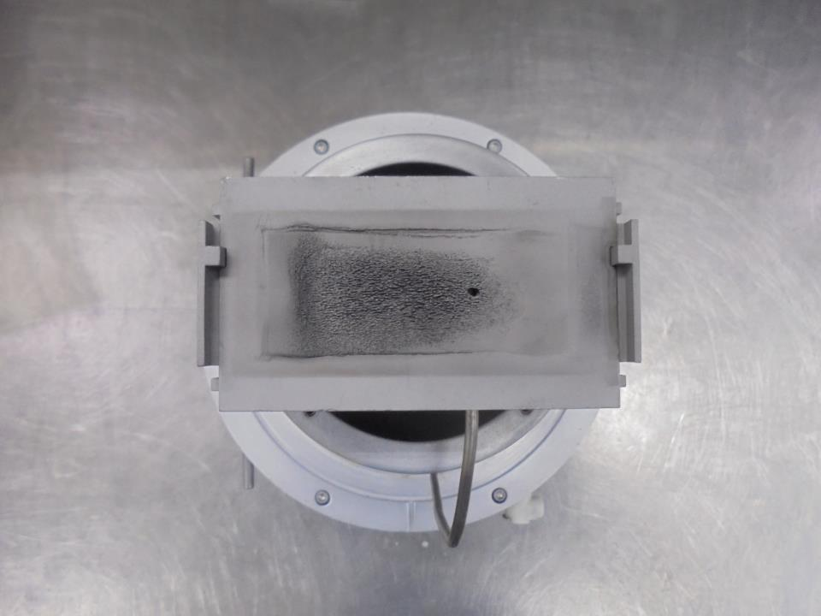
Install ARC CHAMBER ASSY.
Here!

Slide 20
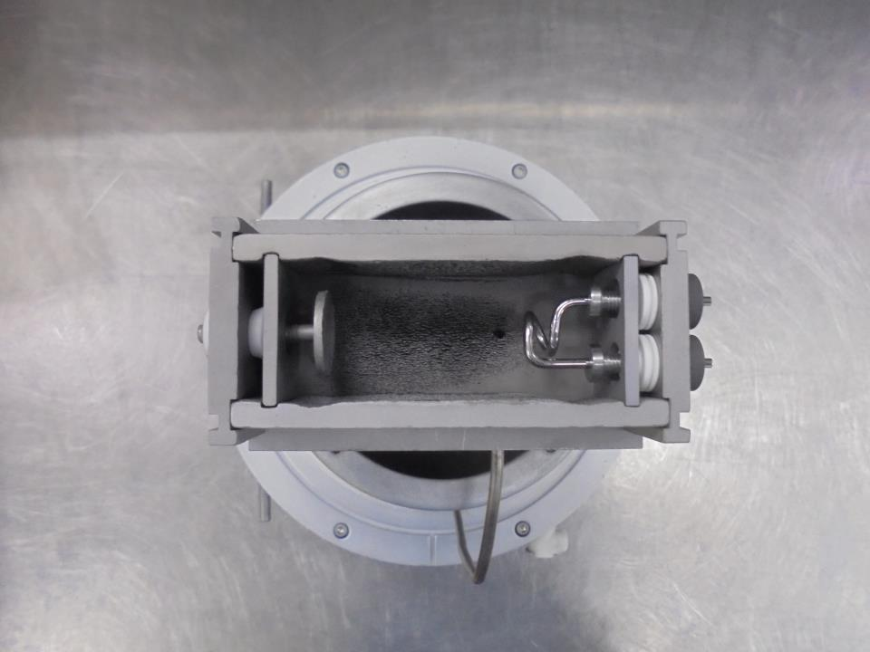
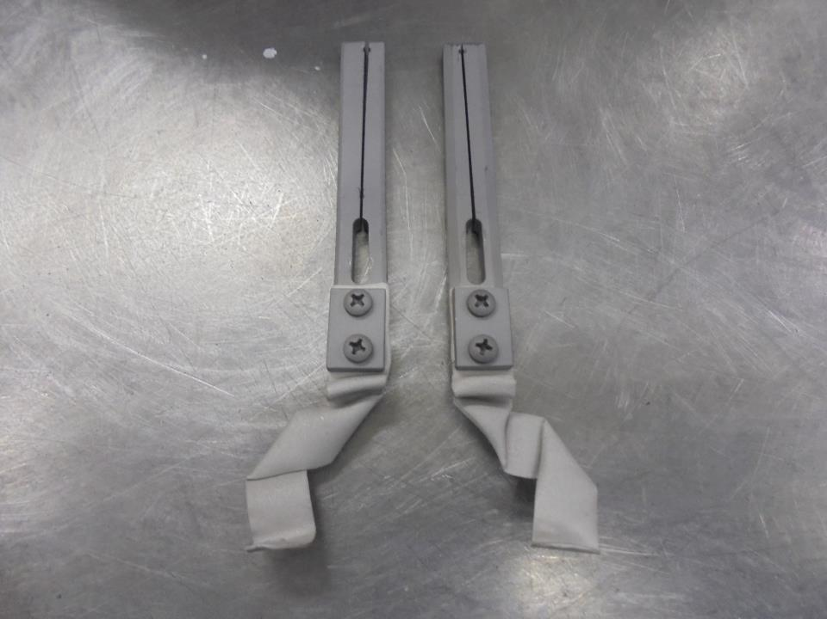
ARC CHAMBER
FILAMENT CLAMP
Double check if the
screws is tighten
Double Check or Make Sure That Both
REPELLER SHIELD and FILAMENT SHIELD
Must Not LOOSE or UNFASTEN on
SIDE PLATES Slot
Filament Strap

Slide 21
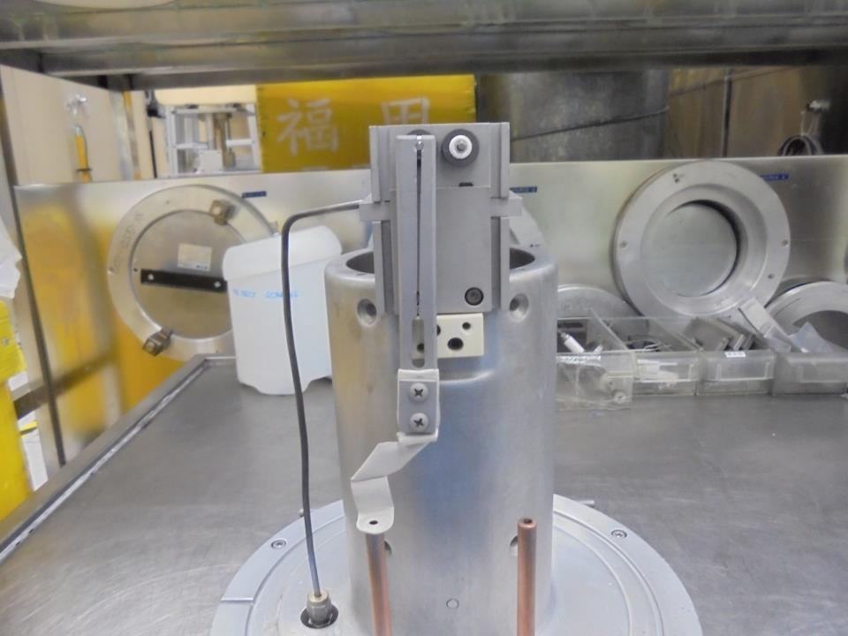
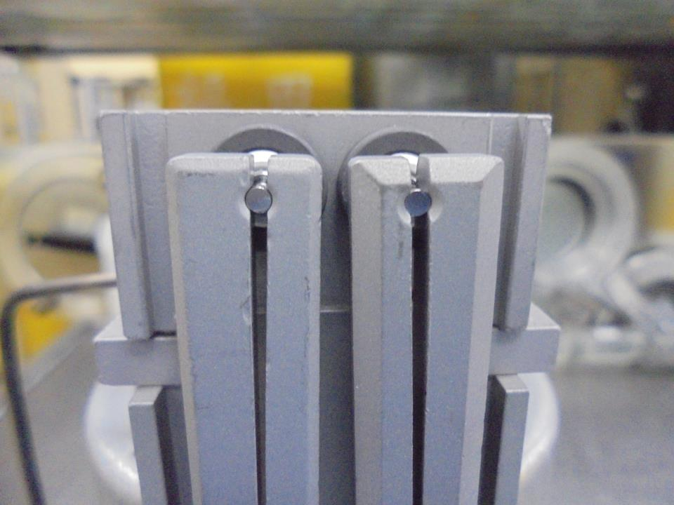
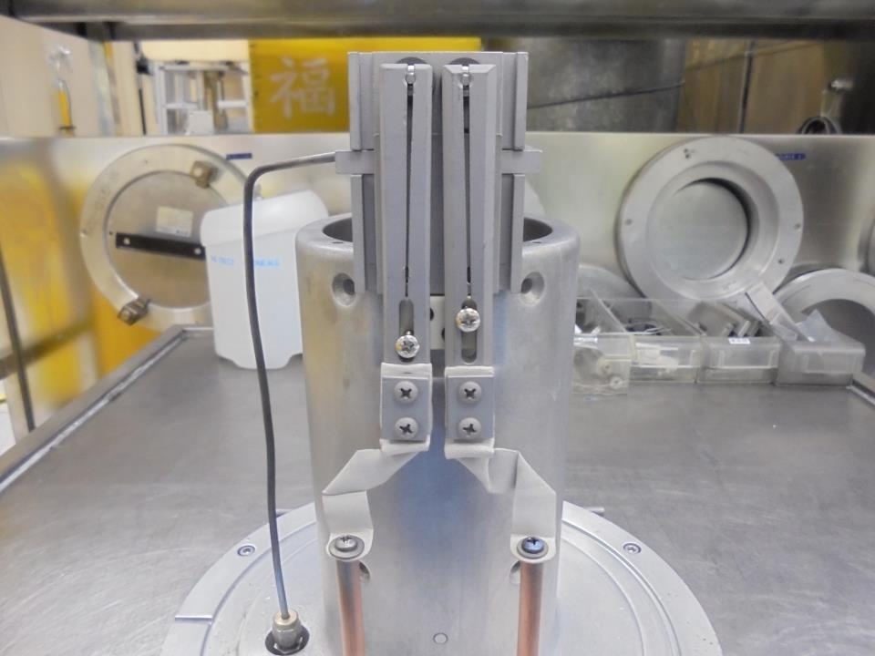
Install Filament Clamp
Make sure the FILAMENT is not Protruded on the CLAMP
Secure Tighten
The Screws…

Slide 22
ISOLATION TEST USING DVM METER

Slide 23
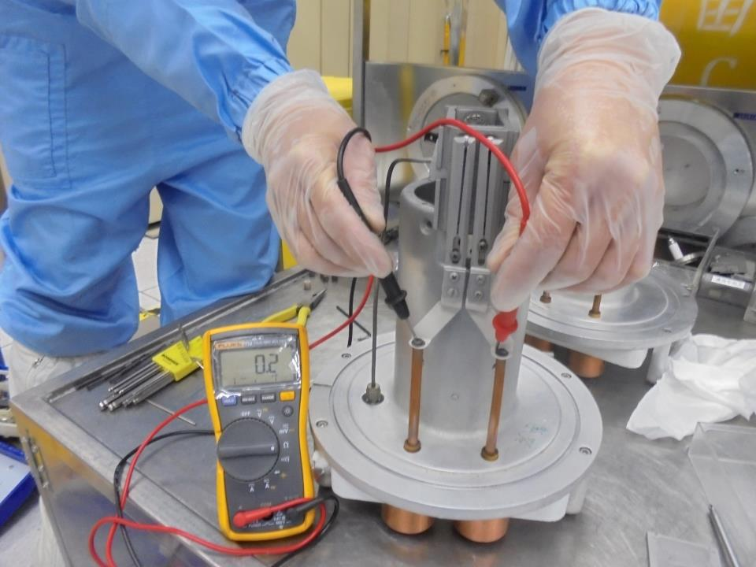
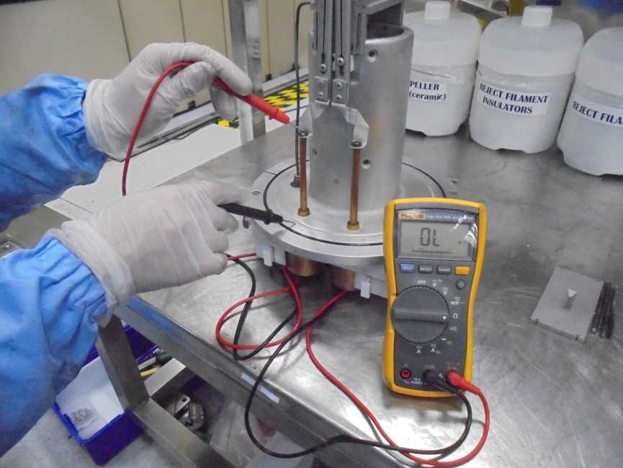
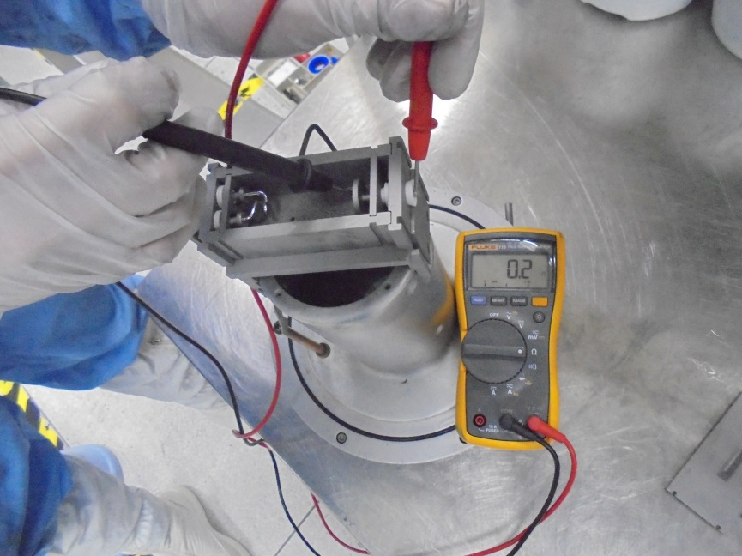
1
FILAMENT
to
FILAMENT
2
FILAMENT Line
to
SOURCE Body
Set to OHM
Ideal Reading
Must Be OVERLOAD !
3
Check The
REPELLER
INSULATOR
IDEAL READING

Slide 24


4
REPELLER
to
SIDE PLATE
5
REPELLER
to
END PLATE
Must Be OVERLOAD !
Must Be OVERLOAD !

Slide 25




RETAINER PIN
ARC SLIT
Install on top and secure with 4 RETAINER PIN
Clean O-RING Slot with IPA

Slide 26






Clean O-RING…
Double Check for any Scratch or Damage…
Install The O-RING
Sign NAME
and DATE
Apply a little amount of High Vacuum Grease
then INSTALL…
Maintenance Done.

